Slide 1
Chi-Square Test

Slide 2
A fundamental issue in genetics is how to determine whether the experimental data fits the theoretical expected results?

Slide 3
For a monohybrid cross:
F2 ratio- 3:1
For a Dihybrid cross:
F2 ration- 9:3:3:1

Slide 4
Goodness of Fit
The chi-square test is a “goodness of fit” test: it answers the question of how well do experimental data fit expectations.
One starts with a theory for how the offspring will be distributed:
“Null hypothesis”. The difference is observed by chance i.e.
Offspring will appear in an expected ratio like 3:1 or 9:3:3:1 etc

Slide 5
Formula
Determine the number of each phenotype that have been observed and how many would be expected given basic genetic theory.
Then calculate the chi-square statistic using this formula.
.

Slide 6
Example
As an example, for a monohybrid cross in F2 offsprings one gets 290 purple and 110 white flowers. Is the observed numbers significant for 3:1 ratio?
Theoretical Expectation: 3/4 : 1/4 ratio.
Expected purple 400 * 3/4 = 300 purple,
Expected White 400 * 1/4 = 100 white.
Observed purple = 290 Observed white, = 110
Applying the numbers in chi-square analysis:
Χ² = (290 - 300)² / 300 + (110 - 100)² / 100
= (-10)² / 300 + (10)² / 100
= 100 / 300 + 100 / 100
= 0.333 + 1.000
= 1.333.
This is our chi-square value: now we need to see what it means and how to use it.

Slide 7
If the results were perfect you get a chi-square value of 0 (because obs = exp).
If you get a high chi-square value: a result from the wrong theory.
Low chi-square value needs to be checked for evaluating the hypothesis.

Slide 8
What is a “reasonable” result?
A result is said to not differ significantly from expectations if deviation is observed once in 20 trials.
“1 time in 20” can be written as a probability value p = 0.05,meaning that in case of true null hypothesis, there is chance of getting this deviation once in 20 trials.
.

Slide 9
How do you calculate the p value from chi square?
One uses the chi square table

Slide 10
Degrees of Freedom
A critical factor in using the chi-square test is the “degrees of freedom”, which is essentially the number of independent random variables involved.
Degrees of freedom is simply the number of classes of offspring minus 1.
For our example, there are 2 classes of offspring: purple and white. Thus, degrees of freedom (d.f.) = 2 -1 = 1.

Slide 11
Critical Chi-Square
Critical values for chi-square are found on tables, sorted by degrees of freedom and probability levels. Be sure to use p = 0.05.
If your calculated chi-square value is greater than the critical value from the table, you “reject the null hypothesis”.
If your chi-square value is less than the critical value, you “fail to reject” the null hypothesis (that is, you accept that your genetic theory about the expected ratio is correct).

Slide 12
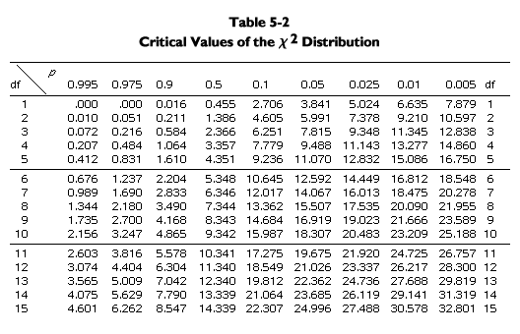
Chi-Square Table
Difference between the observed
and the expected is significant and it can’t be by chance alone.

Slide 13
Using the Table
In the example of 290 purple to 110 white, we calculated a chi-square value of 1.333, with 1 degree of freedom.
Looking at the table, 1 d.f. is the first row, and p = 0.05 is the sixth column. Here we find the critical chi-square value, 3.841.
Since the calculated chi-square, 1.333, is less than the critical value, 3.841, one “fails to reject” the null hypothesis. Thus, an observed ratio of 290 purple to 110 white is a good fit to a 3/4 to 1/4 ratio.

Slide 14
Another Example: from Mendel
phenotype | observed | expected proportion
round yellow | 315 | 9/16
round green | 101 | 3/16
wrinkled yellow | 108 | 3/16
wrinkled green | 32 | 1/16
total | 556

Slide 15
Chi-Square Table

Slide 16
Another Example: from Mendel
phenotype | observed | expected proportion | expected number
round yellow | 315 | 9/16 | 312.75
round green | 101 | 3/16 | 104.25
wrinkled yellow | 108 | 3/16 | 104.25
wrinkled green | 32 | 1/16 | 34.75
total | 556 |  | 556

Slide 17
Calculating the Chi-Square Value
Use the formula.
X² = (315 - 312.75)2 / 312.75
+ (101 - 104.25)2 / 104.25
+ (108 - 104.25)2 / 104.25
+ (32 - 34.75)2 / 34.75
= 0.016 + 0.101 + 0.135 + 0.218
= 0.470.

Slide 18
Finding the Expected Numbers
The total number of offsprings observed.
In this case, 315 + 101 + 108 + 32 = 556.
Then multiply total offspring by the expected proportion:
--expected round yellow = 9/16 * 556 = 312.75
--expected round green = 3/16 * 556 = 104.25
--expected wrinkled yellow = 3/16 * 556 = 104.25
--expected wrinkled green = 1/16 * 556 = 34.75

Slide 19
D.F. and Critical Value
Degrees of freedom is 1 less than the number of classes of offspring. Here, 4 - 1 = 3 d.f.
For 3 d.f. and p = 0.05, the critical chi-square value is 7.815.
Since the observed chi-square (0.470) is less than the critical value, we fail to reject the null hypothesis. We accept Mendel’s conclusion that the observed results for a 9/16 : 3/16 : 3/16 : 1/16 ratio.

Slide 20
Let’s See how sample size affects the Chi square statistic

Slide 21
Calculate Chi square statistic for two arbitrary sample at 1:1 ratio
Sample 1: Observed-15:35,
Expected- 15+35/2= 25
Sample 2: Observed 240:260, Expected = 500/2=250
X²= (15- 25)² + (35- 25)² = 200/25 = 8
25 25
X²= (240- 250)² + (260- 250)² = 200/250 = 0.8
250 250

Slide 22
Chi-Square Table

Slide 23
Question!
In the F2 generation of a certain tomato experiment 3629 fruits were red, while 1175 were yellow. A 3:1 ratio was expected. Are the discrepancies between observed and expected significant?

Slide 24
Phenotype | observed | Expected Proportion | Expected Numbers
Red fruit | 3629 | 3 | 3603 | 0.187
Yellow fruit | 1175 | 1 | 1201 | 0.562
 | Total No.: 4804 | 4 |  | X²= 0.749

Slide 25
In a cross following progenies were obtained, does it follow the 9:3:3:1 ratio?
Round Yellow Peas Round Green Peas Wrinkled Yellow Peas Wrinkled Green Peas
219 81 69 31

Slide 26
Pedigree Analysis
A pedigree is a diagram of family relationships that uses symbols to represent people and lines to represent genetic relationships.
Pedigrees are often used to determine the mode of inheritance (dominant, recessive, etc.) of genetic diseases.

Slide 27
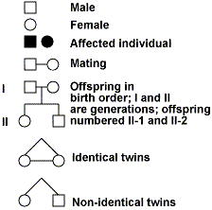
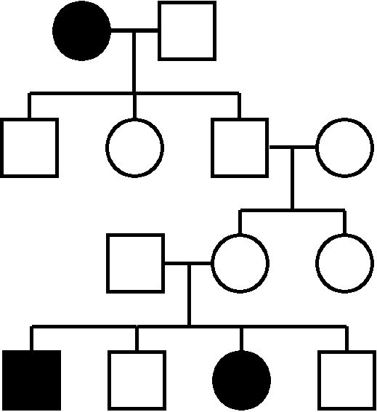
A sample pedigree chart

Slide 28
Pedigree Chart
Squares represent males and circles represent females. Shade in the symbol represent affected individual
Horizontal lines connecting a male and female represent mating.
Vertical lines extending downward from a couple represent their children.

Slide 29
Chi-Square Table

Slide 30
Q2. A woman has a rare abnormality of the eyelids called ptosis, which makes it impossible for her to open her eyes completely. The condition is known to depend on single dominant gene P. The woman’s father had ptosis but her mother was normal. Her paternal grandmother had normal eyelids.
What proportion of her children will be expected to have ptosis if she marries a man with normal eyelid

Slide 31
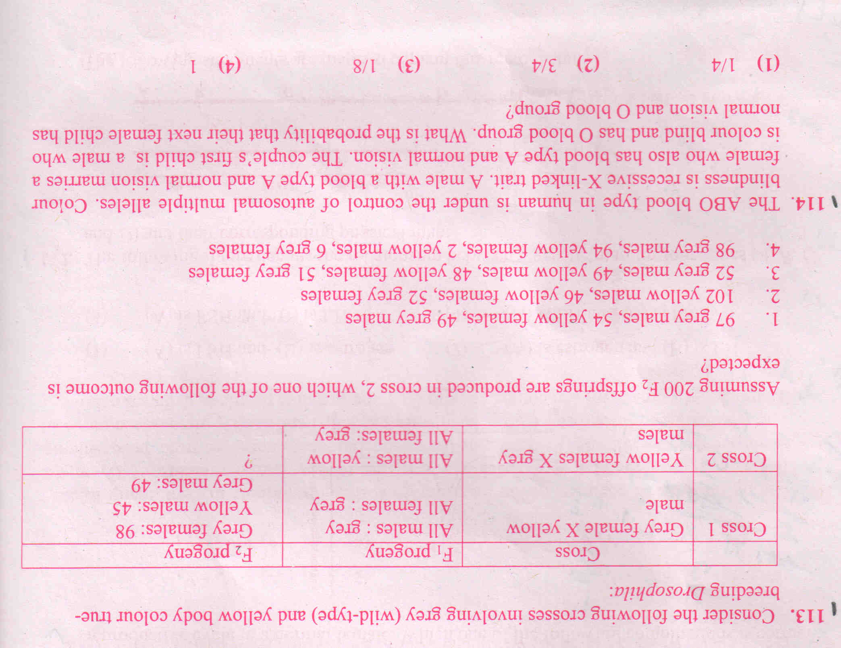
Questions!!

Slide 32
Questions!!

